Slide 3
8 March 2022
Legal Aspects of Space Resources
Christopher Johnson
Space Law Advisor, Secure World Foundation
Adjunct Professor of Law, Georgetown University Law Center
Faculty Member, International Space University

Slide 4
POLL
You come across a startup which claims it is going to mine asteroids for the Space-Space economy. Their tech is 100%. There seems to be a possible market. Do you invest?
Heck yes - I want to be the first in!
Heck yes - even if it doesn’t work I want to foster progress in science
Not sure - there’s a lot of risk
No way - this is economically and legally unviable

Slide 5
Overview of This Presentation
1967 Outer Space Treaty
Rights, Obligations, Prohibitions
1979 Moon Agreement (2 minutes or less)
National Approaches
US, Luxembourg, UAE, Japan
UN Working Group on Space Resources
Artemis Accords
Regulatory Roadmap for Asteroid Miners

Slide 6
1967 Outer Space Treaty
Article 1
Freedom of Exploration and Use

Slide 7
1967 Outer Space Treaty
Article I, Sentence 1
The exploration and use of outer space, including the Moon and other celestial bodies, shall be carried out for the benefit and in the interests of all countries, irrespective of their degree of economic or scientific development, and shall be the province of all mankind.

Slide 8
1967 Outer Space Treaty
Article I, Sentence 2
Outer space, including the Moon and other celestial bodies, shall be free for exploration and use by all States without discrimination of any kind, on a basis of equality and in accordance with international law, and there shall be free access to all areas of celestial bodies.

Slide 9
1967 Outer Space Treaty
Article I, Sentence 3
There shall be freedom of scientific investigation in outer space, including the Moon and other celestial bodies, and States shall facilitate and encourage international cooperation in such investigation.

Slide 10
1967 Outer Space Treaty
Article II
Principle of Non-Appropriation

Slide 11
1967 Outer Space Treaty
Article II
Outer space, including the Moon and other celestial bodies, is not subject to national appropriation by claim of sovereignty, by means of use or occupation, or by any other means.

Slide 12
Summary of International Law Context
The Outer Space Treaty balances
Article I Freedom of Exploration and Use
Article II Principle of Non-Appropriation
Article VI State Obligations of International Responsibility;
Authorization and Supervision; and
Assurance that National Activities Conform with
international law.

Slide 13
What about the Moon Agreement?

Slide 14
What About the Moon Agreement?
Negotiation concluded in 1979, but the Moon Agreement did not enter into force until 1984.
As of 2022, there are 18 States Parties to the Moon Agreement
Armenia, Australia, Austria, Belgium, Chile, Kazakhstan, Kuwait, Lebanon, Mexico, Morocco, Netherlands, Pakistan, Peru, Philippines, Saudi Arabia, Turkey, Uruguay, Venezuela.
4 other States are Signatories to the Moon Agreement
France, Guatemala, India, Romania.
If you want to find, own, use, and sell space resources,
maybe don’t have offices in these countries.

Slide 15
1979 Moon Agreement
Article 1.1
The provisions of this Agreement relating to the Moon shall also apply to other celestial bodies within the solar system, other than the Earth, except insofar as specific legal norms enter into force with respect to any of these celestial bodies.
Therefore the Moon Agreement applies to asteroids.

Slide 16
1979 Moon Agreement
Article 11.1 and 11.2
The Moon and its natural resources are the common heritage of mankind, which finds its expression in the provisions of this Agreement, in particular in paragraph 5 of this article.
The Moon is not subject to national appropriation by any claim of sovereignty, by means of use or occupation, or by any other means.

Slide 17
1979 Moon Agreement
Article 11.3
3. Neither the surface nor the subsurface of the Moon, nor any part
thereof or natural resources in place, shall become property of any State, international intergovernmental or non-governmental organization, national organization or non-governmental entity or of any natural person.
The placement of personnel, space vehicles, equipment, facilities, stations and installations on or below the surface of the Moon, including structures connected with its surface or subsurface, shall not create a right of ownership over the surface or the subsurface of the Moon or any areas thereof. The foregoing provisions are without prejudice to the international regime referred to in paragraph 5 of this article.

Slide 18
1979 Moon Agreement
Article 11.4 and 11.5
4. States Parties have the right to exploration and use of the Moon without discrimination of any kind, on the basis of equality and in accordance with international law and the terms of this Agreement.
5. States Parties to this Agreement hereby undertake to establish an international regime, including appropriate procedures, to govern the exploitation of the natural resources of the Moon as such exploitation is about to become feasible. This provision shall be implemented in accordance with article 18 of this Agreement.

Slide 19
BREAKOUT SESSION! [18 mins]
Company A has identified 10 asteroids and wants to claim their title with the US Mining Authority (Dept of Commerce). They have no asteroid mining plans at present but they have significant allies in US Congress, a long history of aerospace and the move would look good for US foreign policy because of their international connections.
Company B comes along later with the technology and ambition to go to the asteroids immediately, funded by private enterprise, but no long-standing political connections.
If you were the regulator, do you give either company permission to the title? The rest of the world is watching. What precedent do you set for how asteroid resources are allocated?

Slide 20
Regulatory Roadmap for Asteroid Miners
Some open questions remain…
(whether asteroid resources, or lunar resources)
(and... the law is undifferentiated between lunar & asteroid resources, at present)
What governmental agency should you seek permission from?
What is the application process like? What do you need to disclose?
How long does it take, how much does it cost?

Slide 21
Regulatory Roadmap for Asteroid Miners
3. HOW is an interest in a space resource “perfected”?
Just claim it, and it’s yours? Or, you have to “prospect it” first?
What’s to prevent a “gold rush” of claims?
What’s the review process for applications of claims? (Interagency? International?)
Will a regulator enforce claims against “claim jumpers”?
4. What are the limits, or boundaries, of a permit to mine space resources?
Time bound : permittee can mine asteroid x or location x for y years (but no more), or
Extent bound : permittee can recover x tons (but no more) of resource y (but nothing else), or
Activity bound : permittee can mine, but must sell to x, or utilize for only y purpose(s)?

Slide 22
National Approaches

Slide 23
National Space Legislation on Space Mineral Resources
United States of America
US Commercial Space Launch Competitiveness Act (2015)
Luxembourg
Law on the Exploration and Use of Space Resources (2017)
Law on Space Activities (2020)
United Arab Emirates
Federal Law on the Regulation of the Space Sector (2019)
Japan
Space Activities Act (2018)
Space Resources Act (2021)

Slide 24
National Space Legislation on Space Mineral Resources
United States of America
US Commercial Space Launch Competitiveness Act (2015)
Title IV — Space Resources Exploration and Utilization
§51301 Definitions.
In this chapter:
ASTEROID RESOURCE.—The term ‘asteroid resource’ means a space resource found on or within a single asteroid.
SPACE RESOURCE.—
IN GENERAL.—The term ‘space resource’ means an abiotic resource in situ in outer space.
INCLUSIONS.—The term ‘space resource’ includes water and minerals.
UNITED STATES CITIZEN.—The term ‘United States citizen’ has the meaning given the term ‘citizen of the United States’ in section 50902.

Slide 25
National Space Legislation on Space Mineral Resources
United States of America
US Commercial Space Launch Competitiveness Act (2015)
Title IV — Space Resources Exploration and Utilization
§51302 Commercial exploration and commercial recovery
a. In General.—The President, acting through appropriate Federal agencies, shall—
facilitate commercial exploration for and commercial recovery of space resources by United States citizens;
discourage government barriers to the development in the United States of economically viable, safe, and stable industries for commercial exploration for and commercial recovery of space resources in manners consistent with the international obligations of the United States; and
promote the right of United States citizens to engage in commercial exploration for and commercial recovery of space resources free from harmful interference, in accordance with the international obligations of the United States and subject to authorization and continuing supervision by the Federal Government.

Slide 26
National Space Legislation on Space Mineral Resources
United States of America
US Commercial Space Launch Competitiveness Act (2015)
Title IV — Space Resources Exploration and Utilization
§51303 Asteroid resource and space resource rights
A United States citizen engaged in commercial recovery of an asteroid resource or a space resource under this chapter shall be entitled to any asteroid resource or space resource obtained, including to possess, own, transport, use, and sell the asteroid resource or space resource obtained in accordance with applicable law, including the international obligations of the United States.
* See also 2020 Presidential Executive Order on Space Resources
(linked on last slide)

Slide 27
International Approach

Slide 28
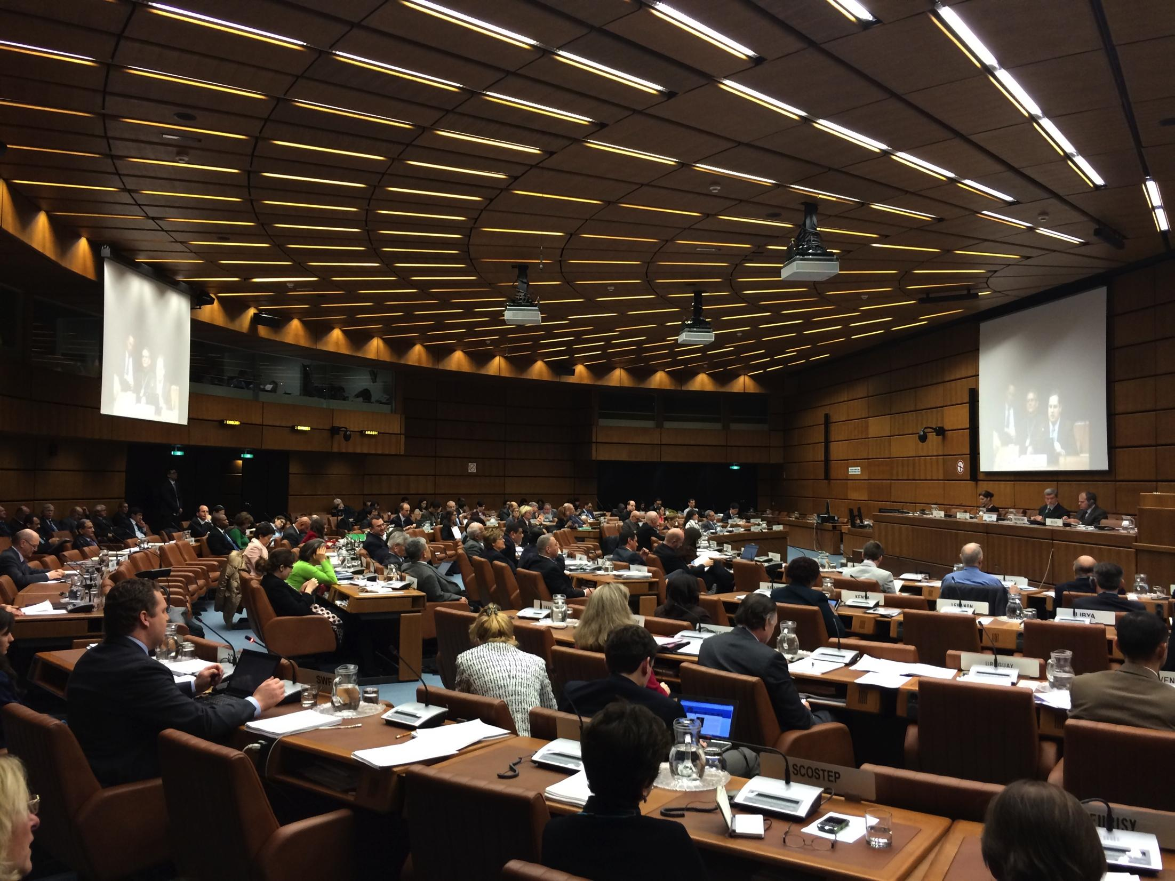
Notes:
Image credit: Chris Johnson

Slide 29
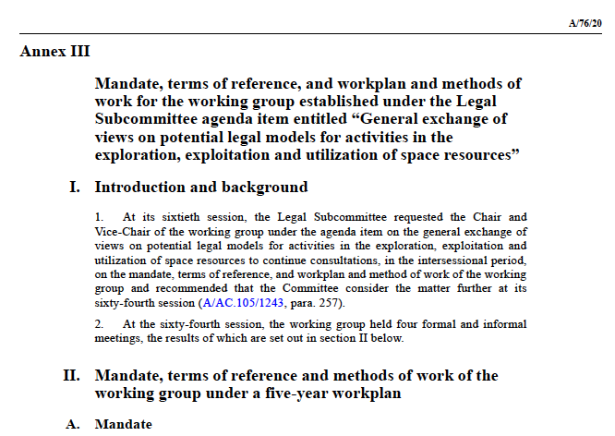
2021 United Nations Committee on the Peaceful Uses of Outer Space (COPUOS)
Mandate, terms of reference, and workplan and methods of work for the working group established under the Legal Subcommittee agenda item entitled “General exchange of views on potential legal models for activities in the exploration, exploitation and utilization of space resources”

Slide 30
United Nations Committee on the Peaceful Uses of Outer Space (COPUOS)
Legal Subcommittee
2021 session report
49. The Subcommittee requested the newly elected Chair and Vice-Chair of the working group to continue consultations, in the intersessional period, on the mandate, terms of reference and method of work of the working group, and to consult with the Chair of the Committee and with the Secretariat regarding the scheduling of the sixty-fourth session of the Committee, so as to enable the working group to meet during that session and benefit from interpretation services.
In that regard, the Subcommittee recommended that the Committee also consider the matter further at its sixty-fourth session.
Latest events: https://www.unoosa.org/oosa/en/ourwork/copuos/lsc/space-resources/index.html
Notes:
https://www.unoosa.org/oosa/en/ourwork/copuos/lsc/space-resources/index.html

Slide 31
UPDATE Artemis Accords
As of March 2022, 18 States Parties to the Artemis Accords:
Australia*, Bahrain, Brazil, Canada, Poland, France, Italy, Israel, Japan, South Korea, Luxembourg, Mexico, New Zealand, Romania, Ukraine, United Arab Emirates, United Kingdom, United States of America.
(*FYI Australia is also a party to the Moon Agreement)
Section 10 — Space Resources
The Signatories note that the utilization of space resources can benefit humankind by providing critical support for safe and sustainable operations.

Slide 32
Artemis Accords
Section 10 – Space Resources
The Signatories emphasize that the extraction and utilization of space resources, including any recovery from the surface or subsurface of the Moon, Mars, comets, or asteroids, should be executed in a manner that complies with the Outer Space Treaty and in support of safe and sustainable space activities. The Signatories affirm that the extraction of space resources does not inherently constitute national appropriation under Article II of the Outer Space Treaty, and that contracts and other legal instruments relating to space resources should be consistent with that Treaty.

Slide 33
Sidenote:
International Space Exploration Coordination Group (ISECG)
currently 26 Space Agencies
Global Exploration Roadmap—Lunar Surface Exploration Scenario
explicitly includes lunar resources characterization and utilization objectives.
https://www.globalspaceexploration.org/?p=1067

Slide 34
Regulatory Roadmap
for Asteroid Miners

Slide 35
Regulatory Roadmap for Asteroid Miners
Asteroid Mining is explicitly permitted by some countries.
There a four (4) Countries with national space legislation, and some with regulatory frameworks.
In the US, still unclear if FAA or Department of Commerce is who would be issuing permits.
More regulatory certainty exists today that even a few years ago
But some open questions remain...

Slide 36
Space Sustainability
and the rule of law in outer space

Slide 37
Thank you for your attention
Chris Johnson
Email: cjohnson@swfound.org
LinkedIn: ChrisJohnsonEsq
Twitter: @cjohnsonesq

Slide 39
References
United Nations Treaties on Outer Space
https://www.unoosa.org/oosa/oosadoc/data/documents/2017/stspace/stspace61rev.2_0.html
US Space Resources Law
https://congress.gov/114/plaws/publ90/PLAW-114publ90.pdf
2020 Executive Order on Space Resources
https://trumpwhitehouse.archives.gov/presidential-actions/executive-order-encouraging-international-support-recovery-use-space-resources/
Artemis Accords
https://www.nasa.gov/specials/artemis-accords/img/Artemis-Accords-signed-13Oct2020.pdf
Luxembourg’s Space Resources Law
https://legilux.public.lu/eli/etat/leg/loi/2017/07/20/a674/jo
United Arab Emirates’s Space Resources Law
https://www.moj.gov.ae/assets/2020/Federal%20Law%20No%2012%20of%202019%20on%20THE%20REGULATION%20OF%20THE%20SPACE%20SECTOR.pdf.aspx
Japan’s Space Resources Law (just news articles so far, no official source)
https://spacenews.com/japan-passes-space-resources-law/
https://spacewatch.global/2021/06/japan-fourth-country-in-the-world-to-pass-space-resources-law/
United Nations Committee on the Peaceful Uses of Outer Space (COPUOS), 2021 Report, Annex III
https://www.unoosa.org/oosa/oosadoc/data/documents/2021/a/a7620_0.html
ISECG Global Exploration Roadmap, Global Exploration Map Supplement
https://www.globalspaceexploration.org/?p=1067

Slide 40
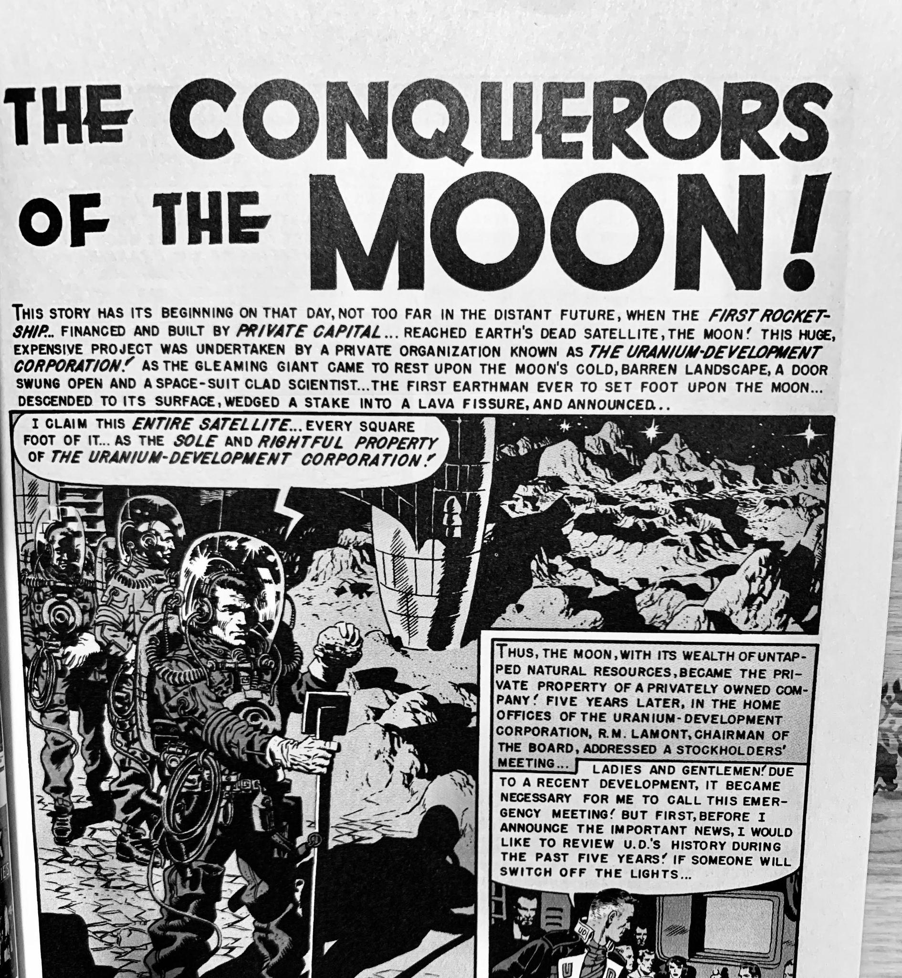
Image Credit: EC Comics, Weird Science #11, 1952.
Notes:
Image Credit: EC Comics, Weird Science #11, 1952.

