Slide 1
“As Brothers and Not as Warriors on the Moon”
E7.5 - Safety Zones on Celestial Bodies and in Outer Space
Christopher Johnson
Space Law Advisor

Slide 2
NASA has identified the following 13 candidate regions at the lunar South Pole for Artemis III:
Faustini Rim A
Peak Near Shackleton
Connecting Ridge
Connecting Ridge Extension
de Gerlache Rim 1
de Gerlache Rim 2
de Gerlache-Kocher Massif
Haworth
Malapert Massif
Leibnitz Beta Plateau
Nobile Rim 1
Nobile Rim 2
Amundsen Rim

Slide 3
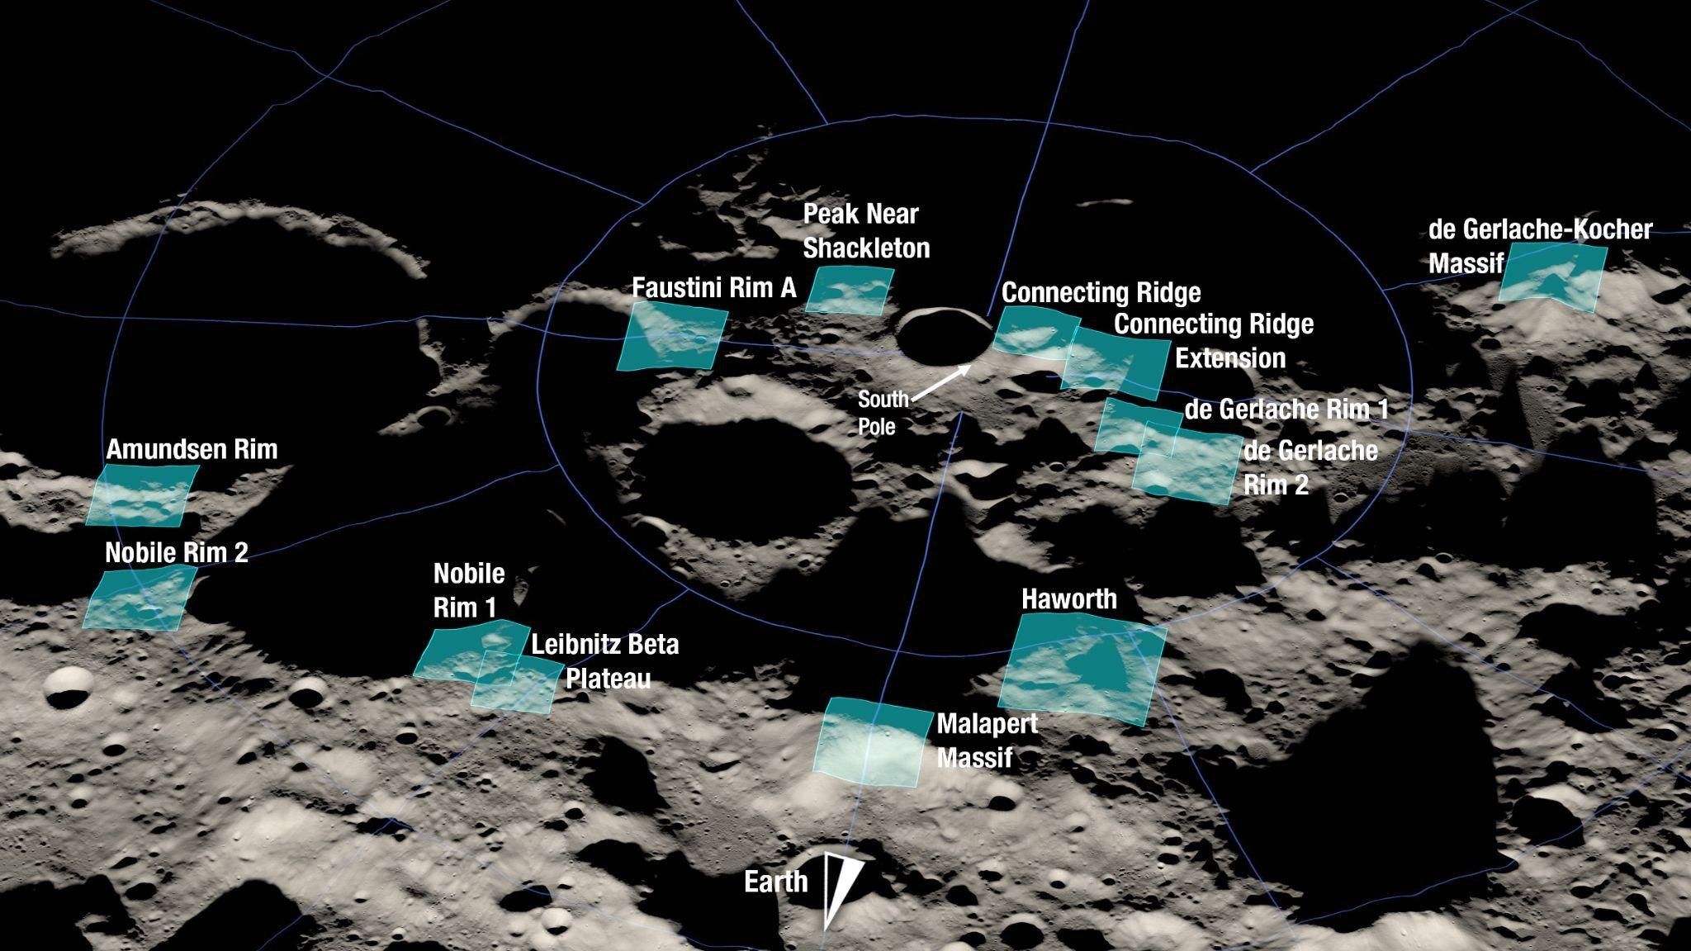
Notes:
13 candidate regions near the Lunar South Pole.
Faustini A, Nobile 2, Haworth, de Gerlache 1 have large, deep, and old Cold Traps (permanently shadowed regions), likely great for science, possibly good for water ice.

Slide 4
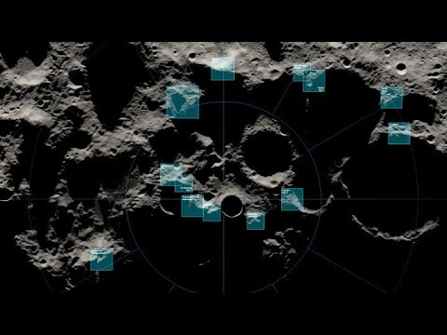
Notes:
13 candidate regions near the Lunar South Pole.
These locations meet safety requirements for landing
Offer lunar resource opportunities
And science opportunities such as data on planetary formation and lunar history
The include mountain summits and crater rims.
1 of these will be selected for the Artemis III landing site. Crewed landing. Sometime in 2025, 2 astronauts on the surface of the moon, for about 1 week.

Slide 5
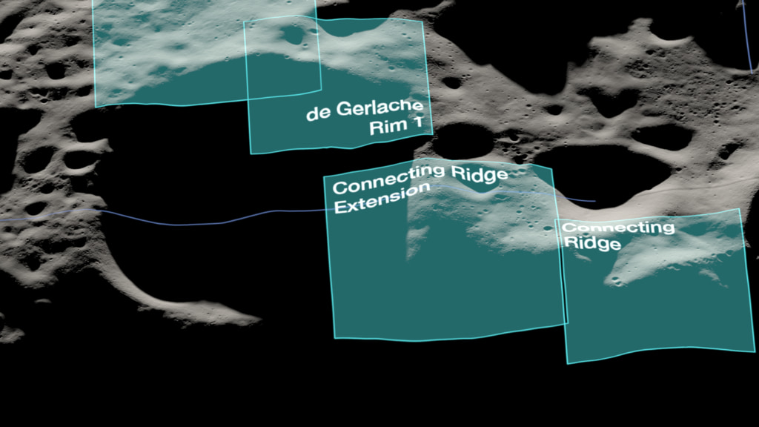
Notes:
13 candidate regions near the Lunar South Pole.

Slide 6
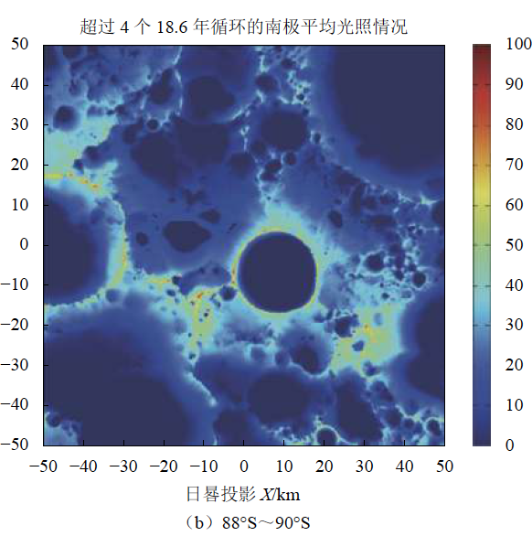
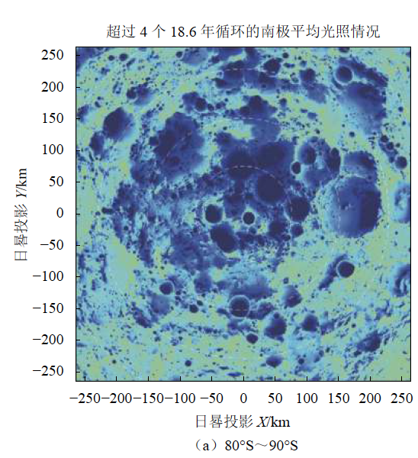
NASA and China are eyeing the same landing sites near the lunar south pole, SpaceNews, 31 Aug. 2022, https://spacenews.com/nasa-and-china-are-eyeing-the-same-landing-sites-near-the-lunar-south-pole/
“Artemis 3 and Chang’e-7 both identify sites near Shackleton, Haworth and Nobile craters as potential landing zones.
The overlap is in part due to both looking to find sites with high elevation and good lighting conditions for conducting mission activities while also being close enough to permanently shadowed craters which are thought to trap volatiles such as water-ice.
It is not clear how the two countries will coordinate their respective lunar plans, with NASA preparing to launch Artemis 1 and China having its own plans for an International Lunar Research Station.”

Slide 7
NASA and China are eyeing the same landing sites near the lunar south pole, SpaceNews, 31 Aug. 2022, https://spacenews.com/nasa-and-china-are-eyeing-the-same-landing-sites-near-the-lunar-south-pole/
Christopher Newman, professor of space law and policy at Northumbria University in the United Kingdom, told SpaceNews that “this is a genuine opportunity for collaboration and cooperation between the two giant powers, and would be an opportunity to show all the rhetoric about space exploration being more than geopolitical in nature.”
“However, in reality it is not hard to see why they both want the same spots. It is prime lunar real estate for in-situ resource utilization. This could be the first potential point of conflict over resources beyond Earth,” Newman said.
“Both parties are signatories to the Outer Space Treaty so nominally accept the use of celestial bodies for peaceful purposes, but it will be interesting to see what happens. A lot will depend on who gets there first. This could add an unwelcome element of competition which threatens security both in space and on Earth.”

Slide 8
General
Lunar Rules
Found in the Outer Space Treaty

Slide 9
Outer Space Treaty
Article IV
Paragraph 2
The Moon and other celestial bodies shall be used by all States Parties to the Treaty exclusively for peaceful purposes. The establishment of military bases, installations and fortifications, the testing of any type of weapons and the conduct of military manoeuvres on celestial bodies shall be forbidden. The use of military personnel for scientific research or for any other peaceful purposes shall not be prohibited. The use of any equipment or facility necessary for peaceful exploration of the Moon and other celestial bodies shall also not be prohibited.
Almost totally prohibits the militarization of the Moon

Slide 10
Outer Space Treaty
Article XII
All stations, installations, equipment and space vehicles on the Moon and other celestial bodies shall be open to representatives of other States Parties to the Treaty on a basis of reciprocity. Such representatives shall give reasonable advance notice of a projected visit, in order that appropriate consultations may be held and that maximum precautions may be taken to assure safety and to avoid interference with normal operations in the facility to be visited.
Visitation rights on the Moon

Slide 11
Safety
Zones
Found in the Artemis Accords

Slide 12
Artemis Accords
Article XI - Deconfliction of Space Activities
5. The Signatories commit to provide each other with necessary information regarding the location and nature of space-based activities under these Accords if a Signatory has reason to believe that the other Signatories’ activities may result in harmful interference with or pose a safety hazard to its space-based activities.

Slide 13
Artemis Accords
Article XI - Deconfliction of Space Activities
7. In order to implement their obligations under the Outer Space Treaty, the Signatories intend to provide notification of their activities and commit to coordinating with any relevant actor to avoid harmful interference. The area wherein this notification and coordination will be implemented to avoid harmful interference is referred to as a ‘safety zone’. A safety zone should be the area in which nominal operations of a relevant activity or an anomalous event could reasonably cause harmful interference. The Signatories intend to observe the following principles related to safety zones:

Slide 14
Artemis Accords
Article XI - Deconfliction of Space Activities
7. The Signatories intend to observe the following principles related to safety zones:
(a) The size and scope of the safety zone, as well as the notice and coordination, should reflect the nature of the operations being conducted and the environment that such operations are conducted in;
(b) The size and scope of the safety zone should be determined in a reasonable manner leveraging commonly accepted scientific and engineering principles;

Slide 15
Artemis Accords
Article XI - Deconfliction of Space Activities
(c) The nature and existence of safety zones is expected to change over time reflecting the status of the relevant operation. If the nature of an operation changes, the operating Signatory should alter the size and scope of the corresponding safety zone as appropriate. Safety zones will ultimately be temporary, ending when the relevant operation ceases; and
(d) The Signatories should promptly notify each other as well as the Secretary-General of the United Nations of the establishment, alteration, or end of any safety zone, consistent with Article XI of the Outer Space Treaty.
Safety zones are not permanent

Slide 16
Artemis Accords
Article XI - Deconfliction of Space Activities
8. The Signatory maintaining a safety zone commits, upon request, to provide any Signatory with the basis for the area in accordance with the national rules and regulations applicable to each Signatory.
Safety zones are between Artemis partners

Slide 17
Artemis Accords
Article XI - Deconfliction of Space Activities
9. The Signatory establishing, maintaining, or ending a safety zone should do so in a manner that protects public and private personnel, equipment, and operations from harmful interference. The Signatories should, as appropriate, make relevant information regarding such safety zones, including the extent and general nature of operations taking place within them, available to the public as soon as practicable and feasible, while taking into account appropriate protections for proprietary and export-controlled information.

Slide 18
Artemis Accords
Article XI - Deconfliction of Space Activities
10. The Signatories commit to respect reasonable safety zones to avoid harmful interference with operations under these Accords, including by providing prior notification to and coordinating with each other before conducting operations in a safety zone established pursuant to these Accords.

Slide 19
Artemis Accords
Article XI - Deconfliction of Space Activities
11. The Signatories commit to use safety zones, which will be expected to change, evolve, or end based on the status of the specific activity, in a manner that encourages scientific discovery and technology demonstration, as well as the safe and efficient extraction and utilization of space resources in support of sustainable space exploration and other operations. The Signatories commit to respect the principle of free access to all areas of celestial bodies and all other provisions of the Outer Space Treaty in their use of safety zones. The Signatories further commit to adjust their usage of safety zones over time based on mutual experiences and consultations with each other and the international community.

Slide 20
Safety Zones from other special regimes of international law
safety zones in international maritime law
safe zones / safe havens / protected areas / security zones in international humanitarian law (IHL)
specially protected zones in antarctic law
air defense identification zones (ADIZs)
flight information regions (FIRs) in aviation law
These concepts were developed amidst the realities and legal constraints of those regimes of law
Space law / Moon law: we can develop our own conception & elements of safety zones, specific to the Moon

Slide 21
Elements of a “Safety Zone”
It is not a “Keep Out Zone” or a “Restricted Zone”
It’s rules govern behavior within that zone.
You might compare it with rules at a public pool, or at the library, inside a hospital, etc.,
Safety Zones might be (nothing is really decided yet):
Time bound (We will operate here for the next 6 years)
Activity bound (If you mine regolith, you must sell it to X with these conditions)
Participant bound (Artemis partners are welcome, but must coordinate with current occupants)

Slide 22
Major Issues
Artemis Accords create safety zones only amongst Artemis Partners
What about other actors in the Moon? China, Russia, others
A significant policy / diplomacy challenge / opportunity to develop some level of coordination between Artemis partners and any other lunar actors.
We have the broad outlines found within space law, including the Artemis Accords
Maybe don’t call them “safety zones”, focus on communication / coordination between lunar actors, not “zones” bound by physical borders.

Slide 23
Remarks at the Signing of the Outer Space Treaty
January 27, 1967
“Secretary Rusk, Mr. Vice President, Mr. Chief Justice, Your Excellencies, ladies and gentlemen:
This is an inspiring moment in the history of the human race.
We are taking the first firm step toward keeping outer space free forever from the implements of war.
It was more than 400 years ago when Martin Luther said:
‘Cannons and firearms are cruel and damnable machines. I believe them to have been the direct suggestion of the devil. If Adam had seen in a vision the horrible instruments that his children were to invent, he would have died of grief.’
Well, I wonder what he would have thought of the far more terrible weapons that we have today.
We have never succeeded in freeing our planet from the implements of war. But if we cannot yet achieve this goal here on earth, we can at least keep the virus from spreading.

Slide 24
Remarks at the Signing of the Outer Space Treaty
January 27, 1967
“We can keep the ugly and wasteful weapons of mass destruction from contaminating space. And that is exactly what this treaty does.
This treaty means that the moon and our sister planets will serve only the purposes of peace and not of war.
It means that orbiting man-made satellites will remain free of nuclear weapons.
It means that astronaut and cosmonaut will meet someday on the surface of the moon as brothers and not as warriors for competing nationalities or ideologies.
It holds promise that the same wisdom and good will which gave us this space treaty will continue to guide us as we seek solutions to the many problems that we have here on this earth.
It is a hopeful and a very promising sign.”

Slide 25
Thank You
Christopher Johnson
cjohnson@swfound.org
Twitter: @ChrisJohnsonEsq
LinkedIn: ChrisJohnsonEsq

Slide 26
References
The American Presidency Project, Remarks at the Remarks at the Signing of the Treaty on Outer Space, https://www.presidency.ucsb.edu/documents/remarks-the-signing-the-treaty-outer-space
Maximilan Both, Chinesen Wollen den Mond Besetzen: NASA-Chef Schlägt Alarm, BILD, 2 July 2022, https://www.bild.de/politik/inland/politik-inland/nasa-chef-schlaegt-alarm-chinesen-wollen-den-mond-besetzen-80490242.bild.html
Bloomberg, China Plans More Moon Missions After Finding New Lunar Mineral, 10 Sept. 2022, https://www.bloomberg.com/news/articles/2022-09-10/china-plans-more-moon-missions-to-rival-nasa-after-finding-new-lunar-mineral
NASA Science Visualization Studio, Artemis III Landing Region Candidates, https://svs.gsfc.nasa.gov/5013
NASA, NASA Identifies Candidate Regions for Landing Next Americans on Moon, 19 Aug. 2022, https://www.nasa.gov/press-release/nasa-identifies-candidate-regions-for-landing-next-americans-on-moon
NASA, Principles for a Safe, Peaceful, and Prosperous Future [Artemis Accords], https://www.nasa.gov/specials/artemis-accords/index.html
Andrew Jones, NASA and China are eyeing the same landing sites near the lunar south pole, SpaceNews, 31 Aug. 2022, https://spacenews.com/nasa-and-china-are-eyeing-the-same-landing-sites-near-the-lunar-south-pole/
Zhang He et al., Proposals for Sites Selection of Soft Landing on Lunar South Polar Region, http://jdse.bit.edu.cn/sktcxb/cn/article/doi/10.15982/j.issn.2095-7777.2020.20191003002

