Slide 1
Preparing for Spectrum Sharing:
Perspectives and Lessons Learned
Challenges In Sharing Weather Satellite Spectrum With Terrestrial Networks
American Meteorological Society and the Secure World Foundation
March 27, 2015
Mark F. Mulholland
Office of System Architecture and Advanced Planning
NOAA Satellite and Information Service

Slide 2
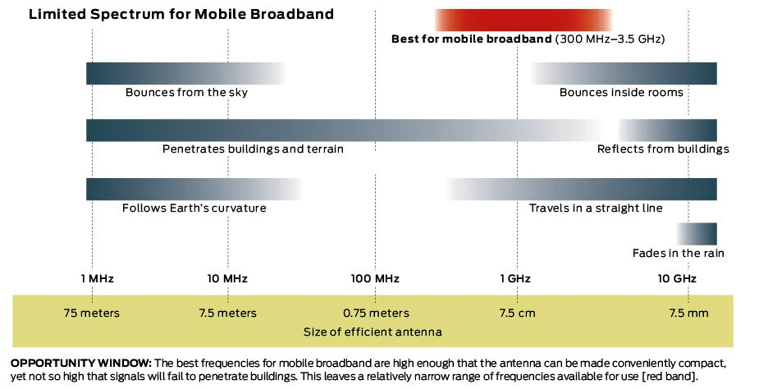
Why Us???
You Are Here
Source: The Great Radio Spectrum Famine, IEEE Inside Technology, October 2010, http://spectrum.ieee.org/telecom/wireless/the-great-radio-spectrum-famine/0

Slide 3
Follow The Money
NOAA Satellite Budget Request, Fiscal Year 2016 (FY 2016 NOAA Budget Summary: http://www.corporateservices.noaa.gov/~nbo/fy16_bluebook/FY2016BudgetSummary-web.pdf) | $2.379 billion
NASA Earth Science Budget Request, Fiscal Year 2016 (FY 2016 President’s Budget Request Summary: http://www.nasa.gov/sites/default/files/files/NASA_FY_2016_Budget_Estimates.pdf) | $1.947 billion
USGS (Landsat) Budget Request, Fiscal Year 2016 (The United States Department of the Interior Budget Justifications and Performance Information, Fiscal Year 2016: http://www.usgs.gov/budget/2016/greenbook/2016_greenbook.pdf) | $0.078 billion
Approximate U.S. Government civil space budget FY 2016 | $4.4 billion
Net “AWS-3” Spectrum Auction Proceeds (FCC Public Notice DA 15-131, dated January 30, 2015: http://www.fcc.gov/document/auction-97-aws-3-winning-bidders) | $41.3 billion

Slide 4
Realities of Spectrum Sharing
Here to stay – Initial auctions successful beyond expectations
Consumer’s demand for broadband will continue to be insatiable
Demand for broadband will grow in other economic sectors
Commercial broadband companies are much more flexible and adaptable than government agencies
Satellite systems are among the least adaptable communications systems
Expectation that government systems will accommodate broadband sector needs

Slide 5
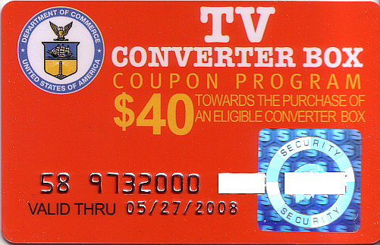
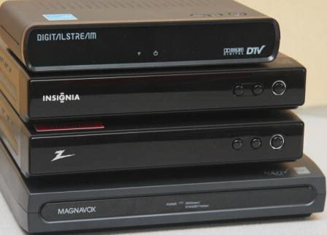
Unfunded Mandates

Slide 6
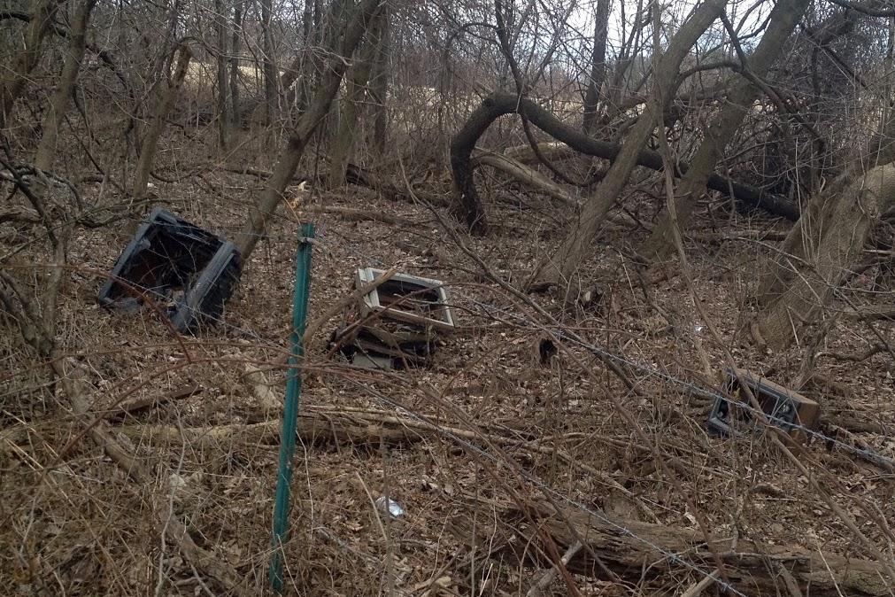
Adverse Consequences

Slide 7
Previous Auction Lessons-Learned
Some analytical techniques outdated
Non-federal and Federal user community engaged, but not well-organized
Regulators and policy-makers understood economic value of EMWIN and geostationary imagery; but,…
  Did not understand criticality of uninterrupted polar data for numerical weather prediction models
  Instituted policy that non-Federal users would not be afforded protection
  Operational forecasting infrastructure protected

Slide 8
Characteristics of Critical Government Locations Using 1675-1695 MHz
1675-1695 MHZ
1695-1710 MHZ
(Source: The Impact of Licensed Shared Use of Spectrum, Deloitte, January 23, 2014
Most difficult to share and least profitable for commercial broadband

Slide 9
Non-Federal User Implications
High probability of protection if you are in or near a coordination zone
High probability of interference if you are in or near one of the Top 100 broadband markets
Lower probability of interference if you are located in a rural area outside one of the Top 100 markets

Slide 10
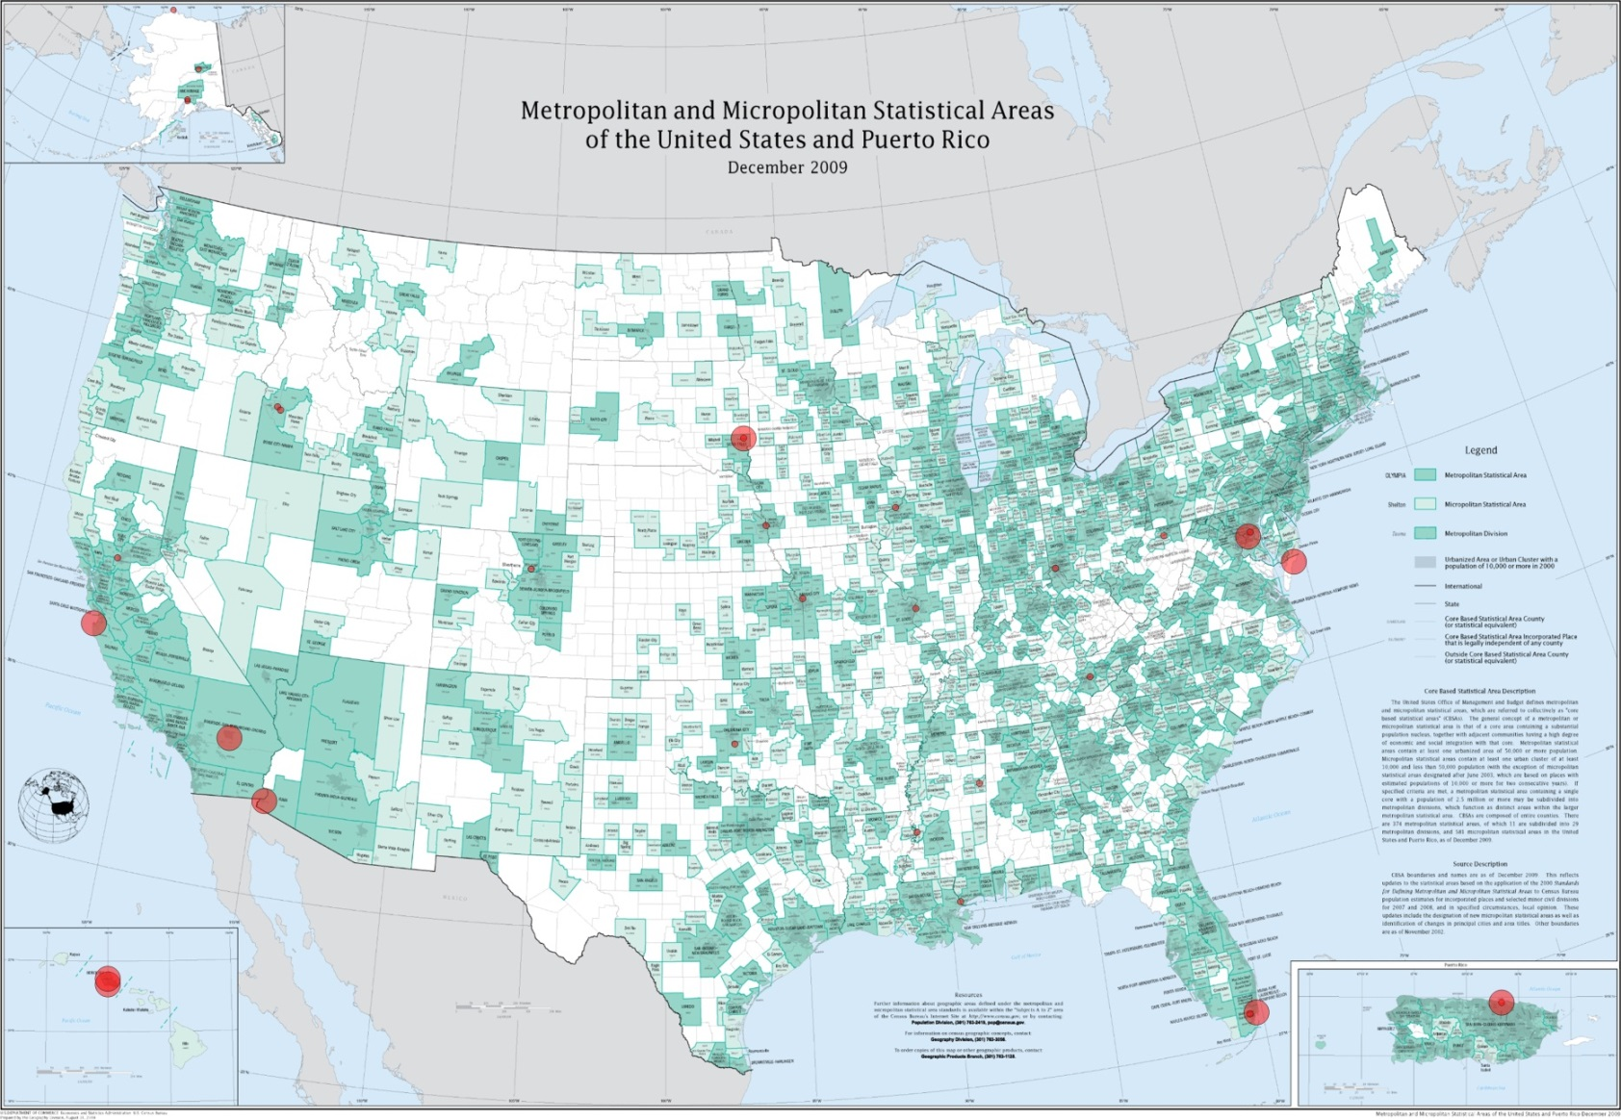
Top 100 Broadband Markets

Slide 11
Suggested User Engagement
Recognize that more weather satellite bands will be auctioned and that it will be harder for us to do our jobs
Begin visible and intense advocacy effort
  Emphasize full scope of emergency management systems that absolutely rely upon EMWIN, GVAR, GRB
  Consider public outreach at “retail” level
Organize frequent, and vocal participation in all rule-making public comment periods
Consider conducting simulations and “Day without…” scenarios to educate the public and ourselves

Slide 12
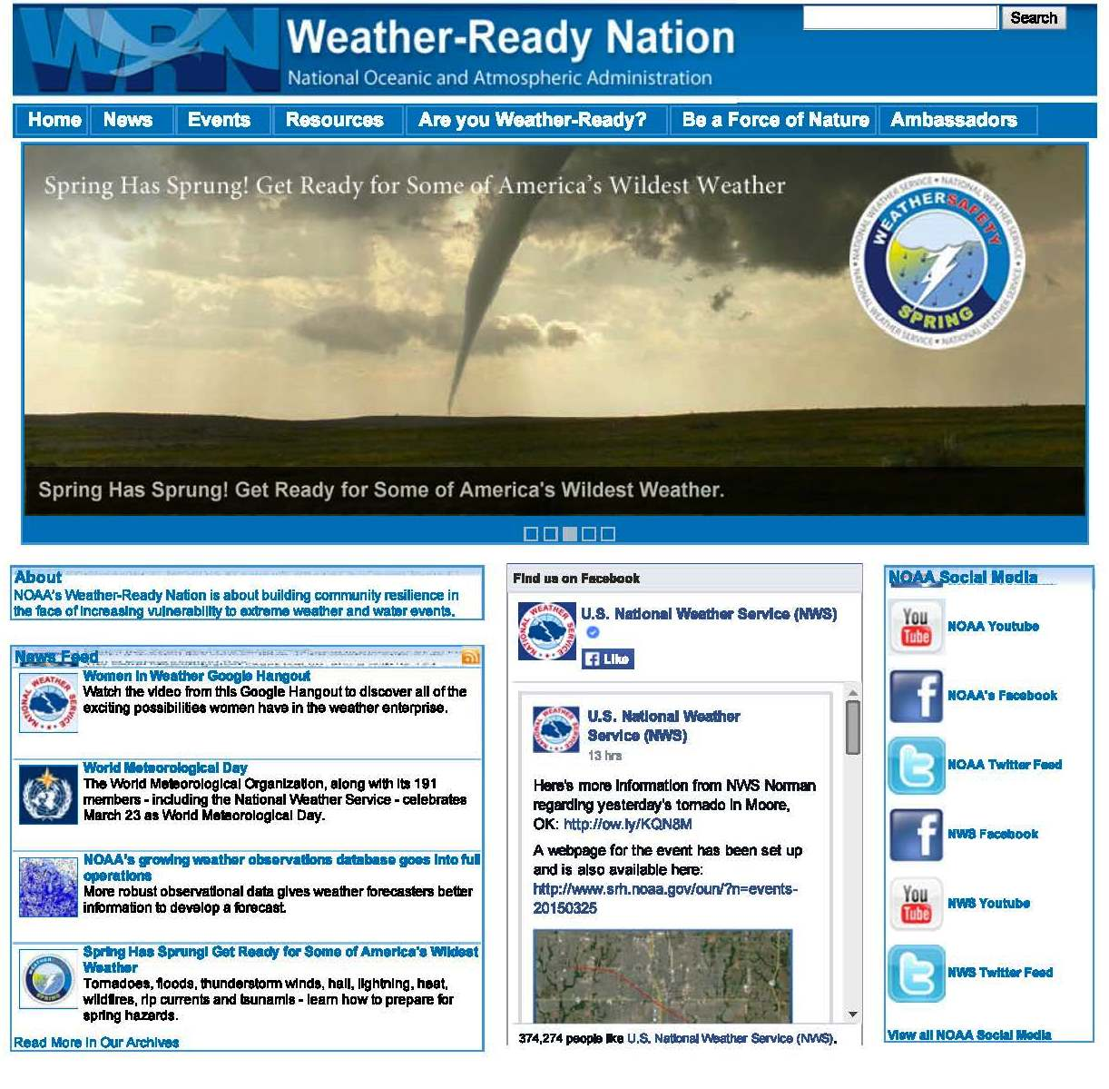
The Bottom Line

