Slide 1
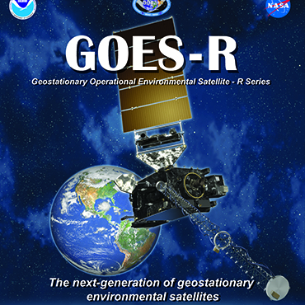
Challenges In Sharing Weather Satellite Spectrum With Terrestrial Networks
March 27, 2015 Washington DC
Presented by Michael Steinberg
Senior Vice President AccuWeather, Inc.
Fellow, American Meteorological Society
Notes:
Thank you for having me here today. I appreciate the opportunity to provide some thoughts and questions on this topic from the perspective of America’s Weather and Climate Industry. While I am not a spectrum expert, I hope my comments will help advance our discussion. AccuWeather and many other companies make extensive use of weather satellite data received from a variety of sources around the world, via several distribution mechanisms.

Slide 2
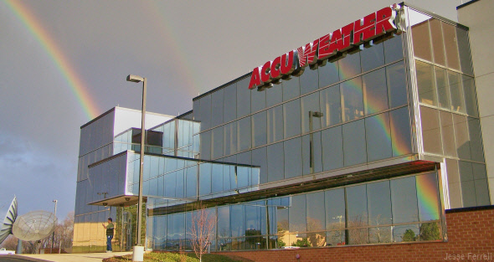
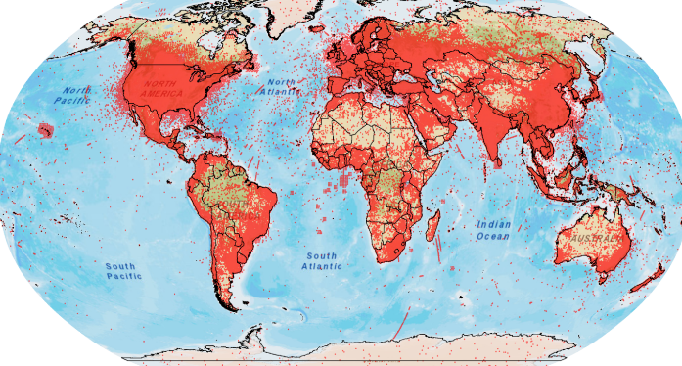
AccuWeather Background
53rd year in service – More than 100 meteorologists plus leading forecast database
Provide weather forecasts and information to more people worldwide than any other source
Content in over 100 languages/dialects for all digital, connected and traditional media
Custom services for thousands of businesses and government agencies
p.2
Email: Michael.Steinberg@AccuWeather.com
Notes:
We use this data in the production of our suite of weather forecasts, warnings and other content delivered to both consumers and business.
The upper picture is of our Global Headquarters and Forecast Center in State College PA. We also have research and operations centers in New York City, Montreal, Wichita, and Edmond OK.
The lower picture shows the data calls we served in one day as red dots. In total, we serve more than 9 billion data calls to 1.5 billion people worldwide each day, with our content available in over 100 languages and dialects - Which makes us the world’s most-viewed weather forecast provider. Our content is available:
For all digital media – including smart phones, tablets, wired and mobile Internet sites, and digital signage
Through connected devices including connected cars, smart homes, and connected appliances
Through traditional media, providing forecasts and other content to nearly 2000 radio and television stations and newspapers – and thereby, to their audiences.
And we provide customized services to more than 1000 businesses and government agencies through AccuWeather Enterprise Solutions, serving 77 of the Fortune 100 companies and 54 of the Fortune Global 100
To do all this we rely upon and receive a large amount of foundational data from NOAA/NWS, including their satellite data. We are a proud NOAA Weather-Ready Nation Ambassador – directly providing actionable weather warnings to business and consumers globally.
We also have agreements with dozens of national met services around the world, various state and local agencies, and a number of private-sector data creators – all of whom supply us with important data we use to generate worldwide forecasts and warnings.

Slide 3
Allocation of Spectrum
Ongoing need to evaluate and optimize federal radio spectrum assignments as change and explosive growth continue to accelerate
Need to consider the critical value of products based upon foundational weather data that help save lives, protect property and grow the American economy.
p.3
Email: Michael.Steinberg@AccuWeather.com
Notes:
The issue of allocation of the radio spectrum and the impacts on companies in the American Weather Industry is an important and interesting one.
On the one hand, we recognize the continued need to evaluate and optimize federal radio spectrum assignments and allocations as consumer electronics, mobile technology and the Internet of Things experience explosive growth – sector growth that in fact, results in significant growth for America’s Weather Industry as new devices and platforms arise all over the world.
On the other hand – this growth cannot put in jeopardy the core delivery methods that are used by governments and AWI to reliably collect, aggregate and deliver foundational weather data in order to provide MISSON CRITICIAL, LIFE SAVING weather products. We cannot – as a Weather Enterprise united in our common goals of saving lives and improving the quality of lives for the world’s citizens – allow this to occur.
Quite simply, these radio spectrums we are discussed are currently utilized for critical purposes that have significant value to the world in saving lives, protecting property and growing the American economy.

Slide 4
The Need For Data
Many non-federal entities leverage satellite ground stations for the speed and reliability of the real-time data retrievals and for additional redundancy along with other access methods.
New satellites and data will make this even more important.
Buffer zones around federal sites do not address the needs of other data users/providers.
p.4
Email: Michael.Steinberg@AccuWeather.com
Notes:
We are one of the many non-federal entities that leverage multiple receive-only ground stations for the reception of real-time weather satellite data. Today, we leverage GVAR data streams from the current GOES satellites and in the future we are excited to leverage GRB broadcast in order to use real-time data from the GOES-R satellites.
Satellite ground stations are important for the speed and reliability of the real-time data retrievals. The internet is also an important delivery method, but for the redundancy and reliability of delivery, users cannot rely on one method to get critical data.
And so, an additional complete data stream of imagery and sounder data is available on an equal basis to all users via broadcast.
These issues are now increasingly important as we move toward GOES-R with the availability of huge volumes of data extremely useful for our critical operations – and completely new data elements such as the global lightning mapper capability.
There has been some suggestion previously of creating “buffer zones” around key federal sites to limit interference – that does not solve this issue because there are many others in AWI and the academic community who reliably need this data for mission critical operations.

Slide 5
Key Questions
How do we gain support of direct and indirect users?
How do we present the message?
How do we effectively engage decision-makers?
How can we leverage existing weather organizations?
What are the best venues?
What level of backup plan do we need in place?
p.5
Email: Michael.Steinberg@AccuWeather.com
Notes:
I certainly don’t have all the answers as to how we address these issues.
So, I’m looking forward to our discussion today, addressing these potential radio spectrum issues directly and collaboratively as a community – recognizing that we all have to work together (as we have done successfully in so many other areas) to ensure decision makers are aware of the critical uses of this information transmitted via these parts of the radio spectrum.
In my view, the key questions include:
How do we get the message out to a wide variety of potentially impacted users to help us gain their support?
How do we present the message coherently and simply enough to make it resonate with decision makers?
How do we effectively educate and engage legislators, the FCC and other decision makers, both individually and collectively as a community?
How can we leverage the existing weather organizations, some of which are actively involved in educational and lobbying efforts, to help with these issues? Including NOAA/NWS, Weather-Ready Nation and Weather-Ready Nation Ambassador Programs, AMS, NWA, AWCIA, NCIM, Weather Coalition.
What are the best venues to educate and build support within the user community - NWS Partners Meetings, NOAA Satellite Conference, AMS Webinars, AMS meetings?
And finally: given the national debt, the deficit, and the political climate, a new source of revenue is very tempting, and the government might decide to sell this spectrum regardless of our view about the value it brings in its current use. So, what level of backup plan do we need in place?
That’s the end of my prepared remarks. I look forward to our discussion.

